Slide 1
Approximating the solution to a system of non-linear algebraic equations

Slide 2
Introduction
In this topic, we will
Describe real-valued functions of two and more variables
Describe tangent surfaces in two dimensions
Discuss the generalization of Taylor series
Discuss simultaneous roots of n expressions in n variables
Frame our root-finding problem as one of finding a zero of a vector-valued function of a vector variable

Slide 3
Tangent lines
Recall Newton’s method:
Convert a non-linear algebraic expression into a linear problem
Find the expression of the tangent line at (x_{k}, f (x_{k}))
The tangent line is a single linear equation in a single unknown
It is trivial to find the solution
f (x)
x_{k}

Slide 4
Root-finding problems
Recall that we will convert a non-linear algebraic equation into a root-finding problem:
x² + 2x – 4y + y² + 1 = cos(xy) + 3
x² + 2x – 4y + y² – 2 – cos(xy) = 0

Slide 5
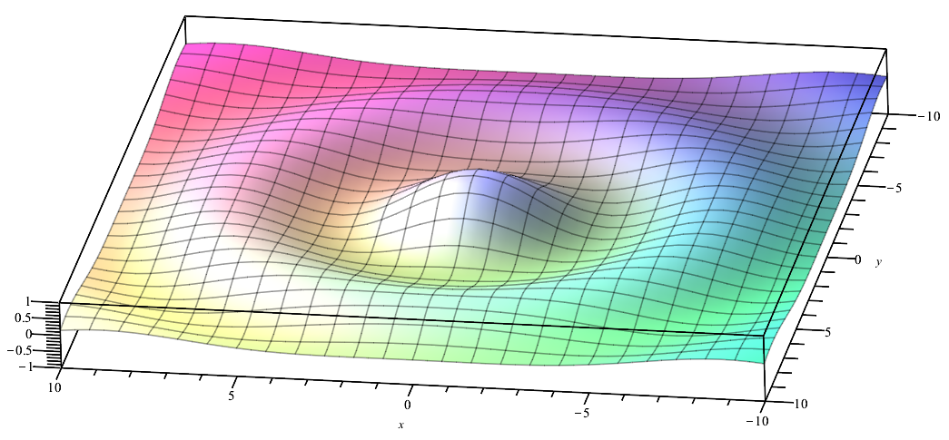
Real-valued functions of two real variables
Suppose we have a real-valued function of two variables

Slide 6
Real-valued functions of a vector variable
It is best to think of this as a real-valued function of a vector variable:

Slide 7
Tangent planes in higher dimensions
Recall that given a differentiable function, we can find a tangent line at any point
Given a differentiable function of a 2-dimensional vector variable, we can find a tangent plane at any point
Given a differentiable function of n-dimensional vector variable, we can find a tangent (n – 1)-dimensional hyperplane at any point

Slide 8
Tangent planes in higher dimensions
In one dimension:
In two dimensions:
In n dimensions:

Slide 9
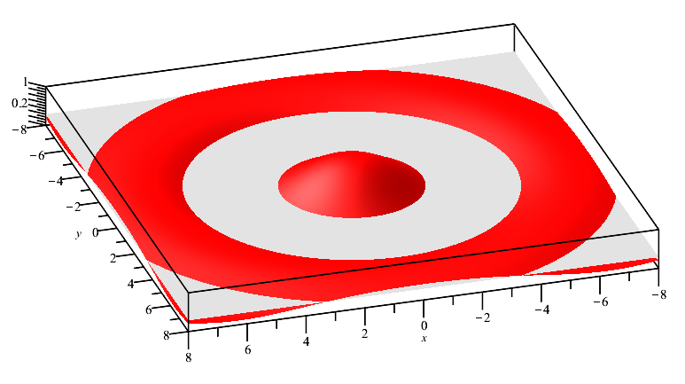
Zeros of a function of two variables
Given a surface, it tends to be zero along curved lines

Slide 10
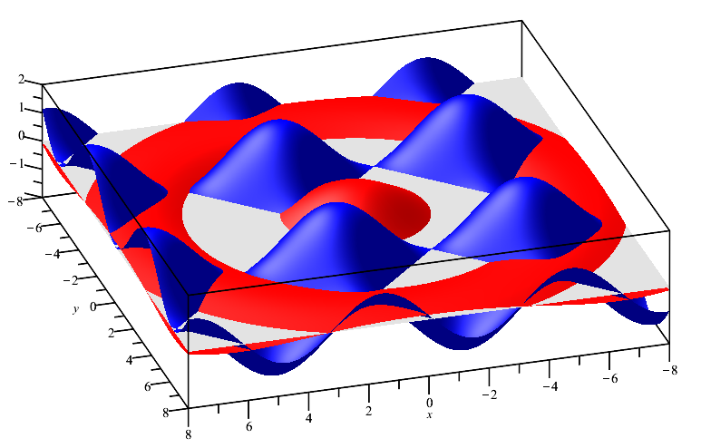
A vector-valued function
Given two surfaces, there are isolated points were both surfaces are simultaneously zero

Slide 11
Solutions to equations
Given two expressions, let us think of them a vector-valued function of a vector variable

Slide 12
Our problem
Thus, we will have an n-dimensional vector-valued function of an n-dimensional vector variable
For example,
We want to find values of u such that
In this case, we have:

Slide 13
Fixed-point iteration
Some of you keeners may have noted the following:
Thus, solving f(u) = 0 is the same as solving g(u) = u and so apply fixed-point iteration
Thus, start with an initial guess u₀, and then u₁ ← g(u₀)

Slide 14
Our problem
In most cases, we will not be able to solve f(u) = 0 exactly
Instead, we will start out with an approximation
Then, like with a real-valued function of a real variable, we will devise a Newton-like method but for higher dimensions
We will find a sequence of vectors u₀, u₁, u₂, … where hopefully

Slide 15
Summary
Following this topic, you now
Are aware that differentiable function of two variables is smooth and has tangent planes
Know that, as with linear equations, we require n expressions in n variables
Know that we will be expressing this as a vector-valued function of a vector variable
Understand the idea of finding the simultaneous root of n expressions in n variables
Are aware that we will use a Newton-like method but in higher dimensions

Slide 16
References
[1] https://en.wikipedia.org/wiki/Nonlinear_system
[2] https://en.wikipedia.org/wiki/Bessel_function

Slide 17
Acknowledgments
Anda Su for noting a mistake in Slide 13 in the conversion of the system of non-linear equations to x = g(x)

Slide 18
Colophon
These slides were prepared using the Cambria typeface. Mathematical equations use Times New Roman, and source code is presented using Consolas. Mathematical equations are prepared in MathType by Design Science, Inc.
Examples may be formulated and checked using Maple by Maplesoft, Inc.
The photographs of flowers and a monarch butter appearing on the title slide and accenting the top of each other slide were taken at the Royal Botanical Gardens in October of 2017 by Douglas Wilhelm Harder. Please see
https://www.rbg.ca/
for more information.

Slide 19
Disclaimer
These slides are provided for the ece 204 Numerical methods course taught at the University of Waterloo. The material in it reflects the author’s best judgment in light of the information available to them at the time of preparation. Any reliance on these course slides by any party for any other purpose are the responsibility of such parties. The authors accept no responsibility for damages, if any, suffered by any party as a result of decisions made or actions based on these course slides for any other purpose than that for which it was intended.

